Slide 1

Department of Computer Science and Engineering DESIGN PROJECT 2 ZOOM AI SIGN LANGUAGE INTERPRETATION
Dharshan R E21113049
Madhulika Reddy G 21113073
SUPERVISORS
Dr.A.Prasiy Evangline, Professor

Slide 2
Introduction
Zoom AI sign language interpretation aims to integrate artificial intelligence (AI) technology with the Zoom platform to facilitate sign language communication. By leveraging AI algorithms, the system enhances the interpretation and understanding of sign language during Zoom meetings, making them more accessible and inclusive for individuals who are deaf or hard of hearing. Through real-time interpretation and communication support, this project seeks to bridge communication gaps and promote equal participation in virtual meetings and discussions.

Slide 3
Goals and Motivation
Goals:
Integrate sign language interpretation capabilities into the GUI, allowing users to communicate using sign language during Zoom meetings.
Develop a gesture recognition system within the GUI using OpenCV and cvzone to interpret sign language gestures in real-time.
Ensure seamless integration between sign language interpretation, Zoom API functionalities, and the GUI interface for a comprehensive communication experience.
Motivation:
Empower individuals who are deaf or hard of hearing to participate fully in virtual meetings by integrating sign language interpretation into the Zoom API GUI interface.
Enhance the usability of online communication platforms by providing intuitive controls and seamless integration between sign language interpretation and Zoom API functionalities.

Slide 4
Literature review/Existing Systems
S.No | Title of the paper/System | Authors | Publication (Name of the Journal/Conference proceedings with Year) | Algorithm/Methodology adopted | Limitations
1. | Review paper on sign language recognition for the deaf and dumb | R. Rumana ,& R . Prema | International Journal of Engineering Research & Technology (IJERT), 2023 | Analyze video using hand detection, feature extraction and classification with traditional machine learning. | Accuracy:80% Often lack sufficient data for less common signs or regional variations within sign languages
2. | Accuracy Enhancement of Hand Gesture Recognition Using CNN | Gyu Tae Park , & V. K Chandrasekar | Institute of Electrical and Electronics Engineers Journal(IEEE), 2023 | Utilizing CNN architecture with diverse datasets and optimized training techniques enhances hand gesture recognition accuracy. | Variability in hand gestures Limited dataset diversity

Slide 5
Literature review/Existing Systems
S.No | Title of the paper/System | Authors | Publication (Name of the Journal/Conference proceedings with Year) | Algorithm/Methodology adopted | Limitations
3. | Deep Learning-Based Standard Sign Language Discrimination | Menglon Zhang ,& Min Zhao | Institute of Electrical and Electronics Engineers Journal(IEEE), 2023 | The FGSFP+TFFR was fine-tuned with pretrained key frame detection model. The DCSR3D+ GRU model was designed to realize comprehensive correctness discrimination of the sign language category and standardization. | Small datasets make it difficult for models to learn complex patterns. Imbalances in the dataset can lead to biased recognition results.
4. | Dynamic Korean Sign Language Recognition | Jung Pil Shin ,& A.S. Musa ,& K. Suzuki | Institute of Electrical and Electronics Engineers Journal(IEEE), 2023 | GCN and an attention-driven neural framework, resulting in a robust and effective model for dynamic Korean Sign Language (KSL) recognition | Small KSL datasets hinder the model's ability to learn and adapt to a wide range of signing variations.

Slide 6
Literature review/Existing Systems
S.No | Title of the paper/System | Authors | Publication (Name of the Journal/Conference proceedings with Year) | Algorithm/Methodology adopted | Limitations
5. | American Sign Language Words Recognition Using Spatio-Temporal Prosodic and Angle Features: A Sequential Learning Approach | B.A. Sunusi & C. Kosin | Institute of Electrical and Electronics Engineers Journal(IEEE), 2022 | FFV-Bi-LSTM to train 3D hand skeletal information of motion and orientation angle features learned from the leap motion controller (LMC). | FFV is trial and error strategy while choosing stable GMM components.
6. | Sign Language Recognition via Late Fusion of Computer Vision and Leap Motion | Jordan J. Bird 1, Anikó Ekárt and Diego R. Faria | Multidisciplinary Digital Publishing Institute(MDPI), 2022 | Computer Vision Feature Extraction and Leap Motion Data Acquisition Late Fusion Integration and Gesture Classification | Limited Leap Motion Range Environmental factors affect accuracy

Slide 7
Literature review/Existing Systems
S.No | Title of the paper/System | Authors | Publication (Name of the Journal/Conference proceedings with Year) | Algorithm/Methodology adopted | Limitations
7. | Real Time Sign Language Interpreter | G.N. Geethu ,& C.S. Arun | International Journal on Electrical, Instrumentation and Communication Engineering, 2022 | Hand sign recognition system was implemented using ARM CORTEX development board. | Low-resolution images or inconsistent signing can impact accuracy.
8. | A Review of the Hand Gesture Recognition System | Noraini Mohamed ,& Nazean Johmar | Institute of Electrical and Electronics Engineers Journal(IEEE), 2021 | Histogram of Oriented Gradient (HOG), Convolutional Neural Network (CNN), and Principal Component Analysis (PCA). | It needs to work with sign variations. It is difficult to be addressed in practice.

Slide 8
Literature review/Existing Systems
S.No | Title of the paper/System | Authors | Publication (Name of the Journal/Conference proceedings with Year) | Algorithm/Methodology adopted | Limitations
9. | Intelligent Sign Language Recognition Using Image Processing | Sawant Pramada, & Nerkar Samiksh,& S. Vaidya | IOSR Journal of Engineering (IOSRJEN) , 2021 | Image Processing and Template matching for better output generation. | These systems may not be able to recognize all signs, especially rare or regional signs.
10. | Sign Language Recognition Using Deep Learning and Computer Vision | Dr. Sabeenian R.S | Journal of Advanced Research in Dynamical and Control Systems, 2021 | A CNN based approach for the recognition and classification of the sign language using computer vision. | It doesn’t support background subtraction when the frames are dropped from a video.

Slide 9
Problem Definition
Lack of accessibility features, such as real-time sign language interpretation, in mainstream virtual communication platforms.
Challenges faced by individuals who are deaf or hard of hearing in expressing themselves effectively during online meetings.
Exclusion of a significant portion of the population from meaningful participation in virtual communication due to inaccessible interfaces.
Limited options for deaf or hard of hearing users to communicate using their preferred mode of expression, such as sign language, during online interactions.
Difficulty in bridging communication gaps between deaf or hard of hearing individuals and other participants in virtual meetings.

Slide 10
Objective
Develop a user-friendly GUI interface that integrates seamlessly with the Zoom API.
Implement real-time sign language interpretation within the GUI to facilitate communication for individuals who are deaf or hard of hearing.
Ensure accessibility and inclusivity in virtual meetings by enabling participants to express themselves effectively using sign language.

Slide 11
Proposed System/Work
System Overview: Our system uses cutting-edge computer vision algorithms to recognize and translate sign language gestures in real-time. We'll seamlessly integrate this feature into Zoom.
Mediapipe Hand Tracking Algorithm: Our algorithm, trained on a diverse dataset of sign language gestures, accurately detects and tracks hand movements. This ensures reliable translation during video calls.
Integration with Zoom: We'll leverage Zoom's API to smoothly integrate our Sign Language recognition system into the platform. Users can activate and customize the feature within the Zoom interface.

Slide 12
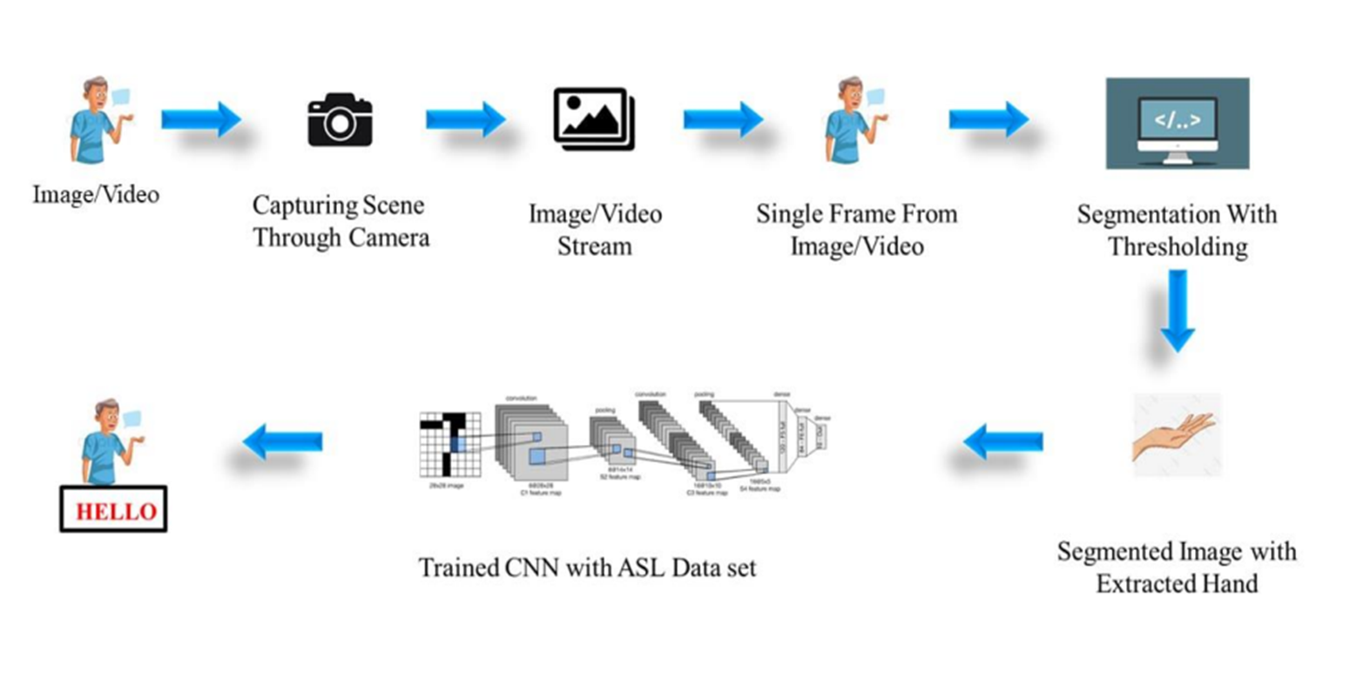
ARCHITECHTURE DIAGRAM

Slide 13
Modular Description
TKINTER: Used for creating the GUI interface.
CV2: Used for capturing video frames and processing them for gesture recognition.
CVZONE.HANDTRACKINGMODULE: Used for hand tracking within the video frames.
NUMPY: Used for array manipulation, particularly in image processing tasks.
MATH: Used for mathematical calculations, such as resizing images.
THREADING: Used for managing concurrent operations, for streaming and gesture recognition.
SOCKET: Used for networking tasks, such as retrieving local IP addresses.
VIDSTREAM: Used for streaming video and audio data over a network connection

Slide 14
Results and discussions
Result:
Real-time interpretation of sign language gestures enhances communication during Zoom meetings.
Successful integration of sign language interpretation with Zoom API GUI interface.
Improved accessibility and inclusivity for deaf or hard of hearing individuals in virtual meetings.
Application promotes inclusivity and ensures effective participation for all users.
Discussion:
User-friendly GUI controls facilitate seamless management of Zoom meetings and interpretation.
Technical achievement in real-time interpretation using computer vision techniques.

Slide 15
Conclusion and Future Work
Conclusion:
Integration of sign language interpretation enhances inclusivity in virtual meetings.
User-friendly interface facilitates seamless management of Zoom meetings and interpretation.
The application represents a significant step towards addressing accessibility needs in communication platforms.
Continued refinement and user feedback will optimize functionality and effectiveness.
Future Work:
Improve gesture recognition accuracy and expand support for additional sign language gestures.
Gather user feedback to refine functionality and enhance user experience, particularly from deaf or hard of hearing users.

Slide 16
References
References:
"Real-time hand gesture recognition using a depth sensor" by Mohamed E. K. Soliman and Mohamed S. Kamel, published in the Journal of Ambient Intelligence and Humanized Computing in 2021.
"A review of hand gesture recognition techniques for human-computer interaction" by Xiaofei Du, Xinghao Chen, and Yulong Dong, published in the Journal of Visual Communication and Image Representation in 2021.
"Deep learning for hand gesture recognition: A survey" by Ahmed Elgammal and Rania Ibrahim, published in the IEEE Access journal in 2021.
"Hand gesture recognition using deep learning: A survey" by S. Suresh, A. K. Singh, and R. K. Singh, published in the Journal of Ambient Intelligence and Humanized Computing in 2022.
"Hand gesture recognition using convolutional neural networks" by Wei-Chih Hung, Yu-Ting Chen, and Jyh-Cheng Chen, published in the Journal of Ambient Intelligence and Humanized Computing in 2021.
"MediaPipe: A Framework for Perceptual Computing" by Google Research, 2021.

Slide 17
THANK YOU

